Slide 1
IMAGE ENCRYPTION USING CAPSNET
Under the guidance of NITHYASRI .A Assistant Professor, Department of AI | Presented by K.LAVANYA DEVI - 927621BAD026 M.MADHUMITHRA - 927621BAD029 R.MAHALAKSHMI - 927621BAD030 S.YUVASHREE - 927621BAD063

Slide 2
Agenda
Objectives
Problem Statement
Hardware/Software Specifications
Existing system
Literature Survey
Modules
Implementation
References

Slide 3
Objectives
Develop a more secure encryption algorithm that is resistant to hide the images from unauthorized access.
By using Capsnet neural network in order to secure the image from an illegal remote.

Slide 4
Problem Statement
The advanced computer processors have made it easy to illegally access the transmitted data on the Internet. So, the challenge of secure image encryption and decryption is daunting, as a single flaw in the process can leave the data unsafe.

Slide 5
Hardware Specification
Multicore CPU
Graphics Processing Unit (NVIDIA)
16GB of RAM for 512*512 resolution of a image
6.4GB of storage for dataset
Power supply

Slide 6
Software Specification
Programming language-Python
Deep learning frameworks-TensorFlow,PyTorch and keras
OpenCv
Python Library-Pillow,NumPY
Python package –PyCryptodome
IDE-Jupyter notebook

Slide 7
Existing System
Preprocessing: The input image is preprocessed to prepare it for encryption. This may involve converting the image to grayscale, resizing it to a fixed size, and normalizing the pixel values.
Feature extraction: The image features are extracted using a convolutional neural network (CNN). In this paper, the authors used the ResNet50 CNN architecture for feature extraction.
Chaotic encryption: The authors used a chaotic system to generate a key for encryption and logistic map to generate a key sequence.

Slide 8
Literature Survey
S.NO | AUTHOR NAME | TITLE | TECHNIQUES USED
1. | S.Agarwal, , R. Khanna, and R. Gupta, | Image Encryption Using a Cascade of Convolutional Neural Networks. | Convolutional neural networks (CNNs)
2. | Y. Dong, H. Zhang, W. Zhang, and Y. Liu | Image Encryption Using a Cascade of Deep Neural Networks. | Deep neural networks (DNNs)
3. | S. S. Salim, S. A. Rashid, and H. A. Jalab | Image Encryption Based on Cascade Convolutional Neural Networks with DNA Sequence Operations. | Cascade of convolutional neural networks

Slide 9
Modules
Module 1:CapsNet Routing
Module 2:Capsule Reconstruction
Module 3: Key Generation
Module 4: Dropout
Module 5:Adversarial Training

Slide 10
CapsNet Routing Module: This module is responsible for routing the input data through a series of capsules, where each capsule represents a specific part or feature of the image. Capsule Reconstruction Module: After routing the input data through the CapsNet, the capsule reconstruction module is used to reconstruct the encrypted image. Key Generation Module: A key generation module can be added to the CapsNet architecture to generate a secret key for encrypting and decrypting the image. Dropout Module: A dropout module can be added to the CapsNet architecture to introduce random noise into the capsule outputs, which can help to improve the security of the encryption. Adversarial Training Module: An adversarial training module can be added to the CapsNet architecture to improve the robustness of the encryption against attacks.

Slide 11
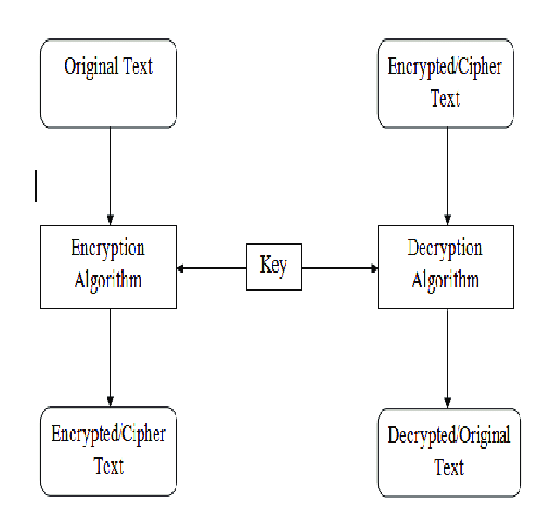
Block Diagram

Slide 12
IMPLEMENTATION

Slide 13
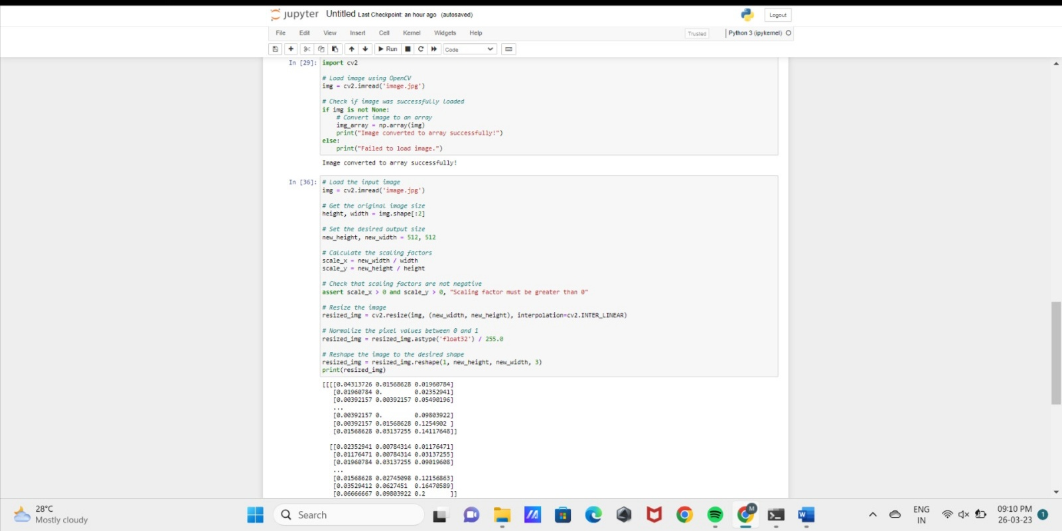
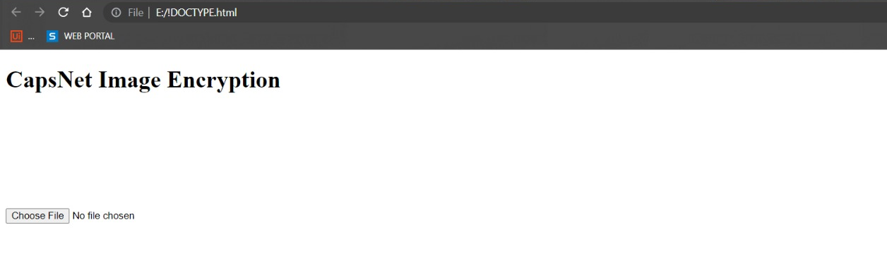
Output Screenshot

Slide 14
References
1.Wang, H., Li, Y., Li, C., Li, H., & Liu, Y. (2020). An image encryption scheme using capsule network and DNA sequence operations. Signal Processing: Image Communication, 84, 115799. https://doi.org/10.1016/j.image.2020.115799
2.Yang, S., Guo, Y., & Sun, J. (2021). Image encryption based on capsule network and fractional Fourier transform. Multimedia Tools and Applications, 80(11), 16525-16542. https://doi.org/10.1007/s11042-021-10923-6
3."Capsule Networks: A Survey" by Xiao Sun et al. (2019). This survey paper provides an overview of CapsNet research, including architecture, applications, and challenges.
4. "Capsule Network Performance on Complex Data" by Abhinav Gupta et al. (2022). This paper evaluates the performance of CapsNets on complex data
5. "Capsule Networks for Object Recognition: A Survey" by Seyed Mehran Kazemi and Ali Jalalifar (2021)

Slide 15
Thank You

